Slide 1

BIS 15L- Winter 2022
Analyzing Contributions to Happiness
Presented and Developed by:
Shuyi Bian, Carmina Inguito, and Yutong Ji

Slide 2
Overview
02
01
03
04
Introduction
Putting Together Data
Reference
Column Explanation
Merge Data Frame
Explore Data
Visualization
Conclusion
Diagrams and Plots
Interactive Apps
Overall analysis

Slide 3

01
Introduction
Reference
Column Explanation

Slide 4
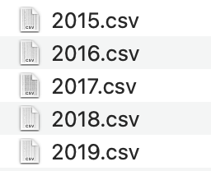
Data Information
Data frames from Kaggle: https://www.kaggle.com/unsdsn/world-happiness
The happiness scores and rankings use data from the Gallup World Poll. The scores are based on answers to the main life evaluation question asked in the poll.
5 Year happiness survey

Slide 5
Column Explanation
Happiness Score: Ask respondents to rate their current value from 0 (worst) to 10 (best)
Happiness Rank: Rank of countries or regions based on overall happiness score.
6 Happiness Factors: 1) Economy GDP per capita
2) Family The extent to which these factors
3) Health life expectancy contributes to happiness score
4) Freedom
5) Trust to government
6) Generocity (social support)

Slide 6
02
Putting Together Data
Merge Data Frame
Explore Data Frame

Slide 7
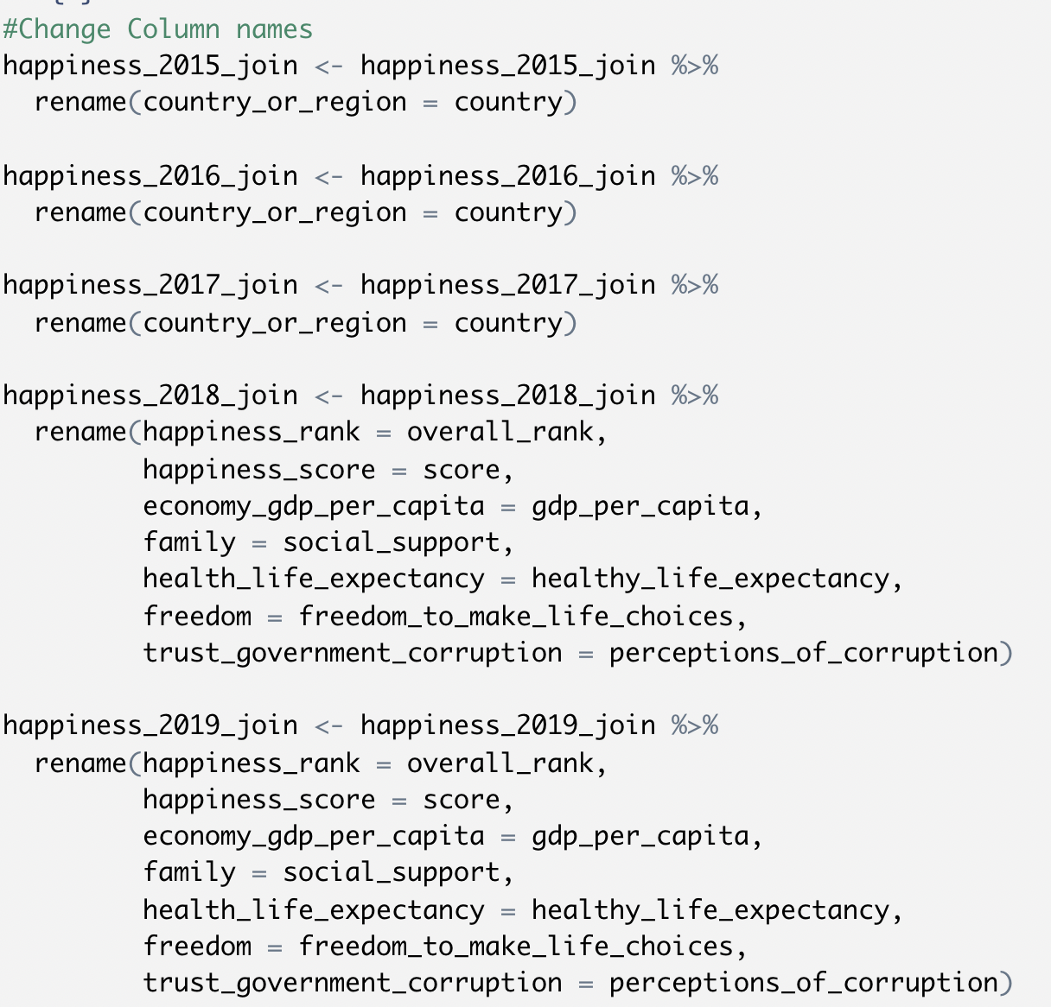
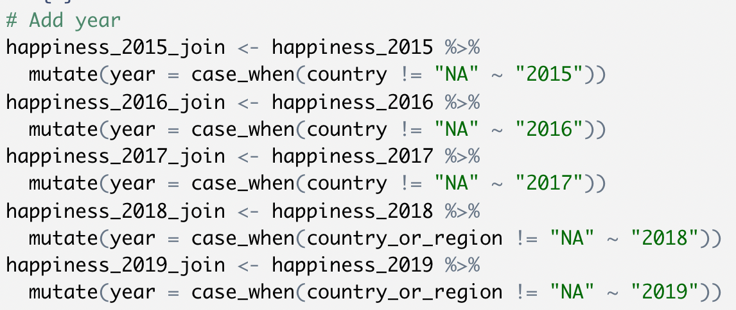
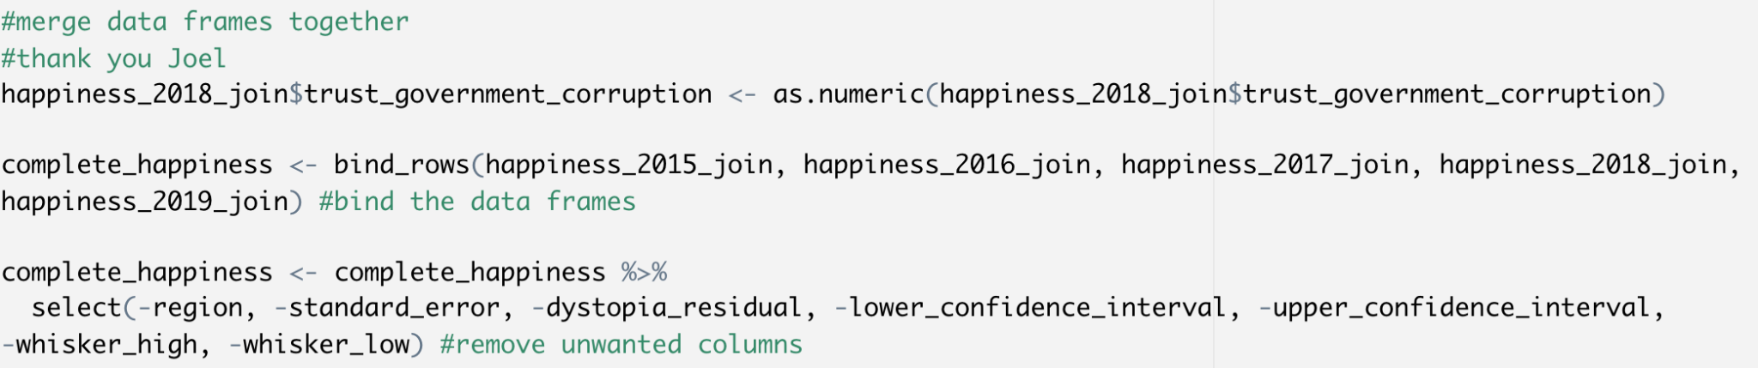
Merge Data Frames

Slide 8
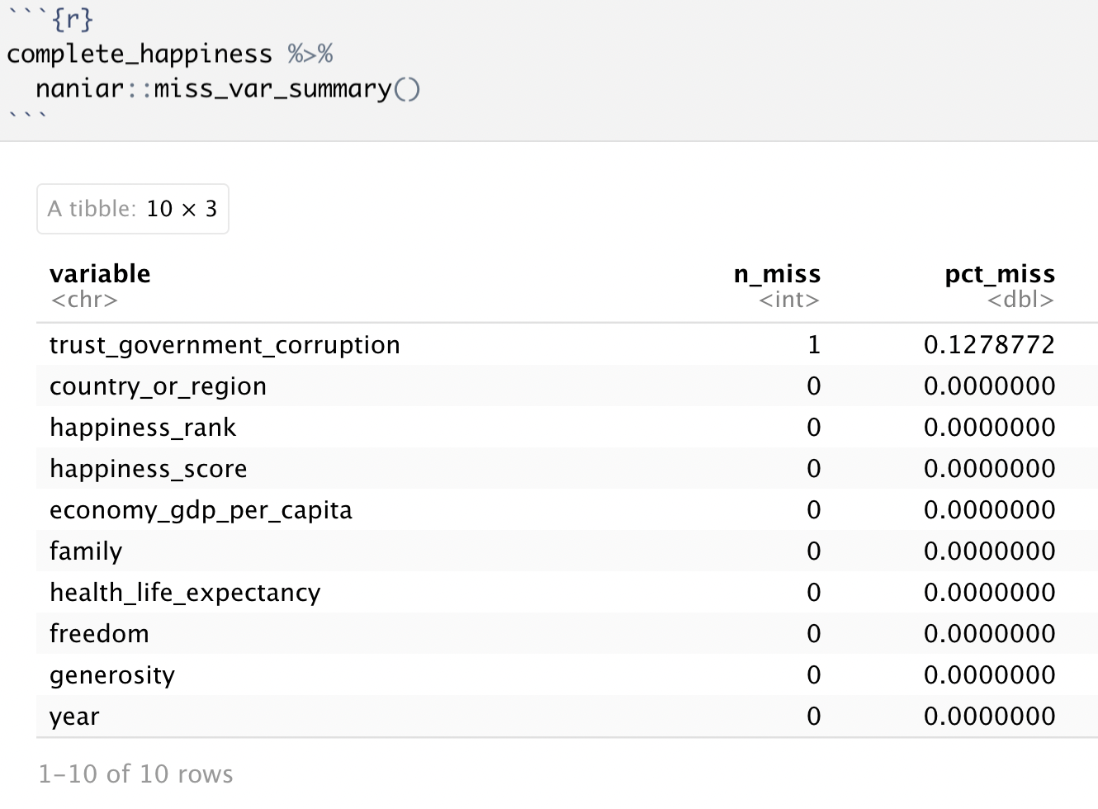
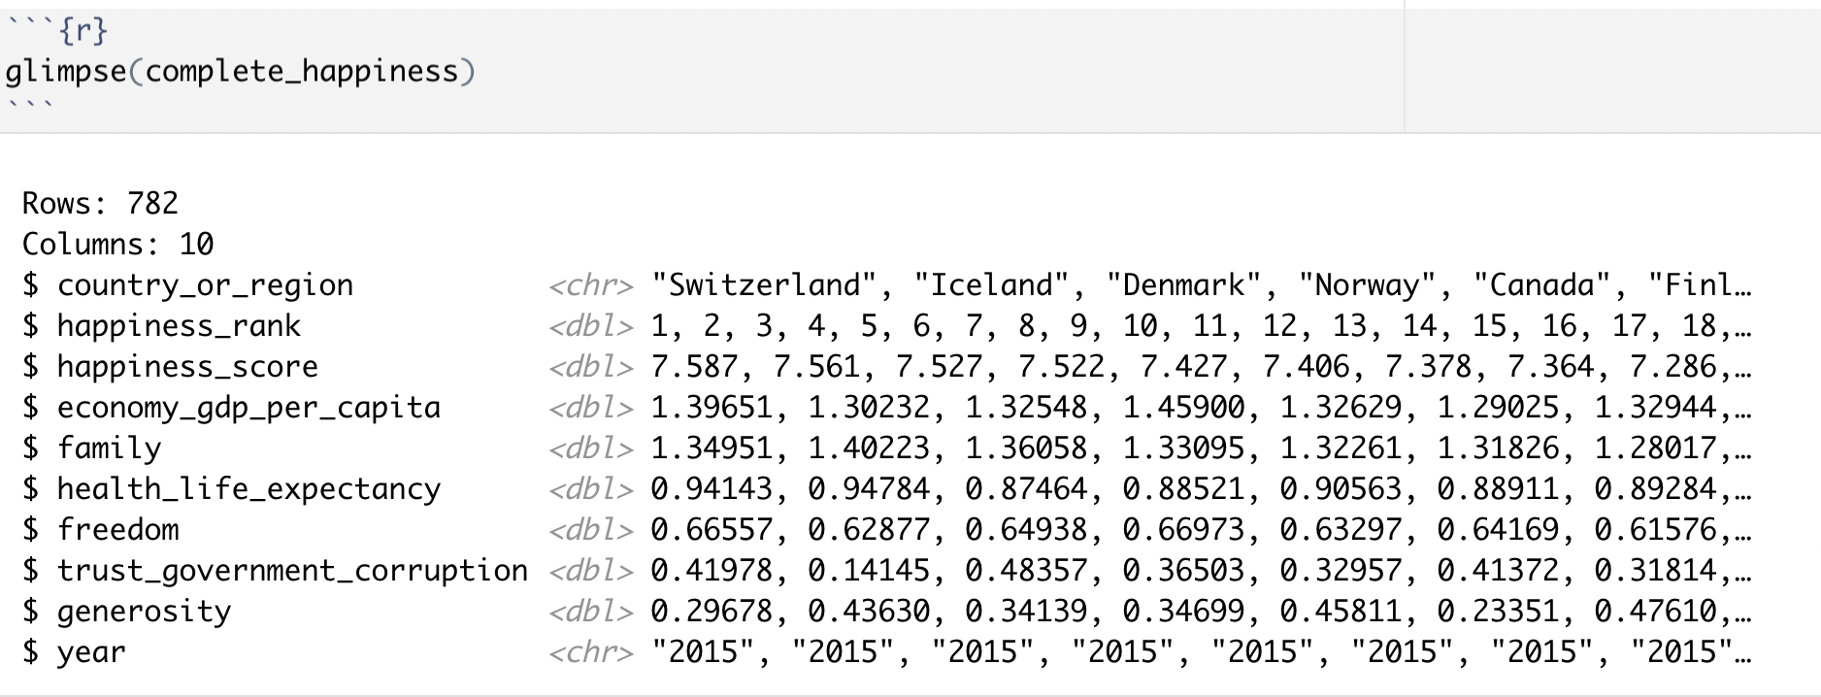
Explore Data Frames
Notes:
Note: NAs

Slide 9
03
Visualization
Diagrams, Plots, and Interactive Apps

Slide 10
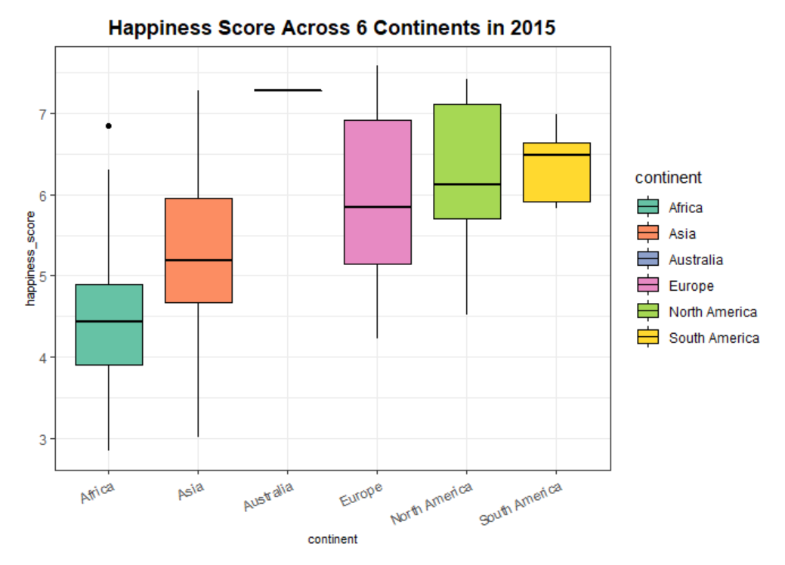
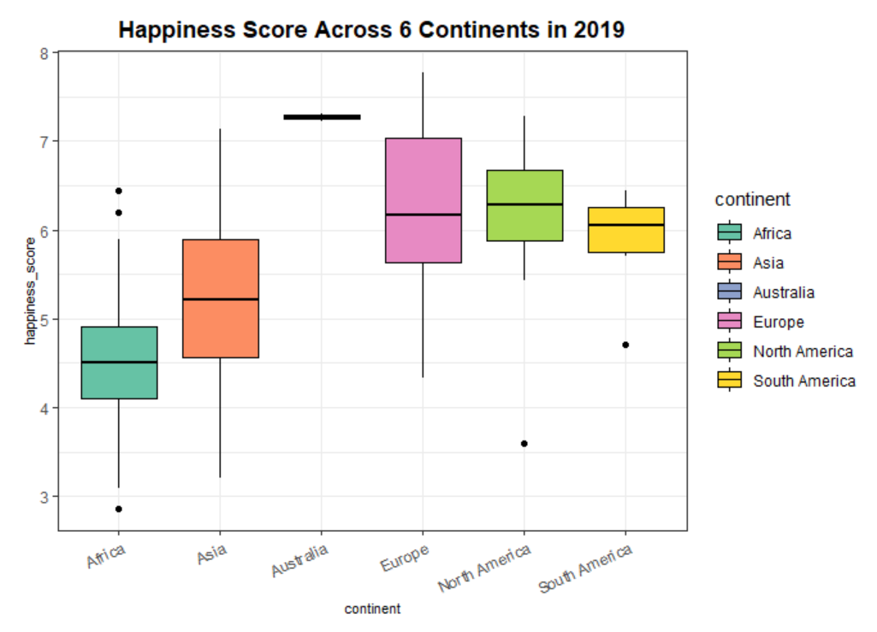
Happiness Score by Continents (2015 & 2019)
– Using Boxplots –

Slide 11
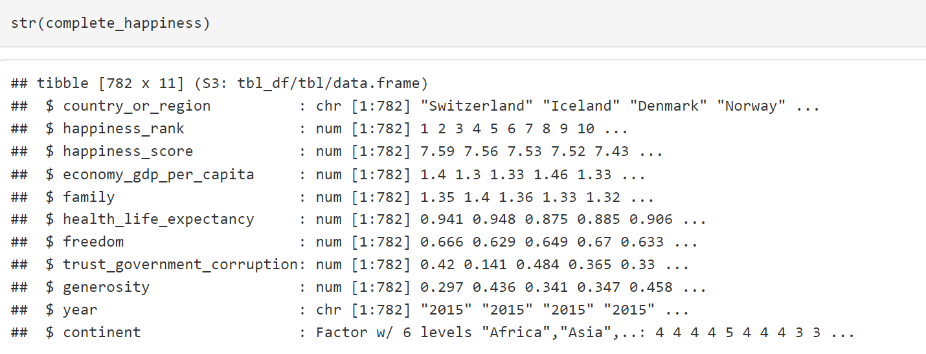
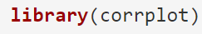
What factors have a weak or strong relationship with their happiness score?.. Or is there no relationship at all?
– Using a Correlation Plot –

Slide 12
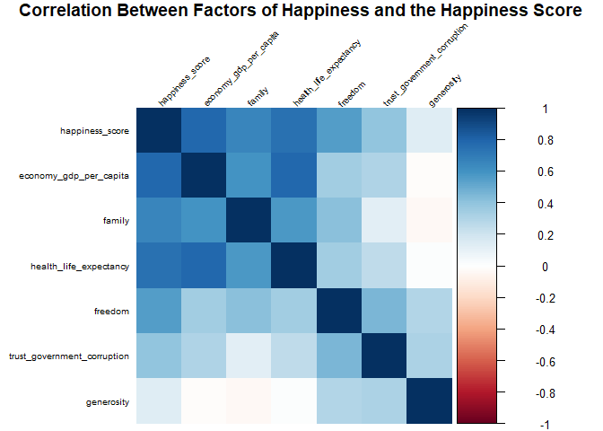
Visualization of Correlation Plot [1/2]

Slide 13
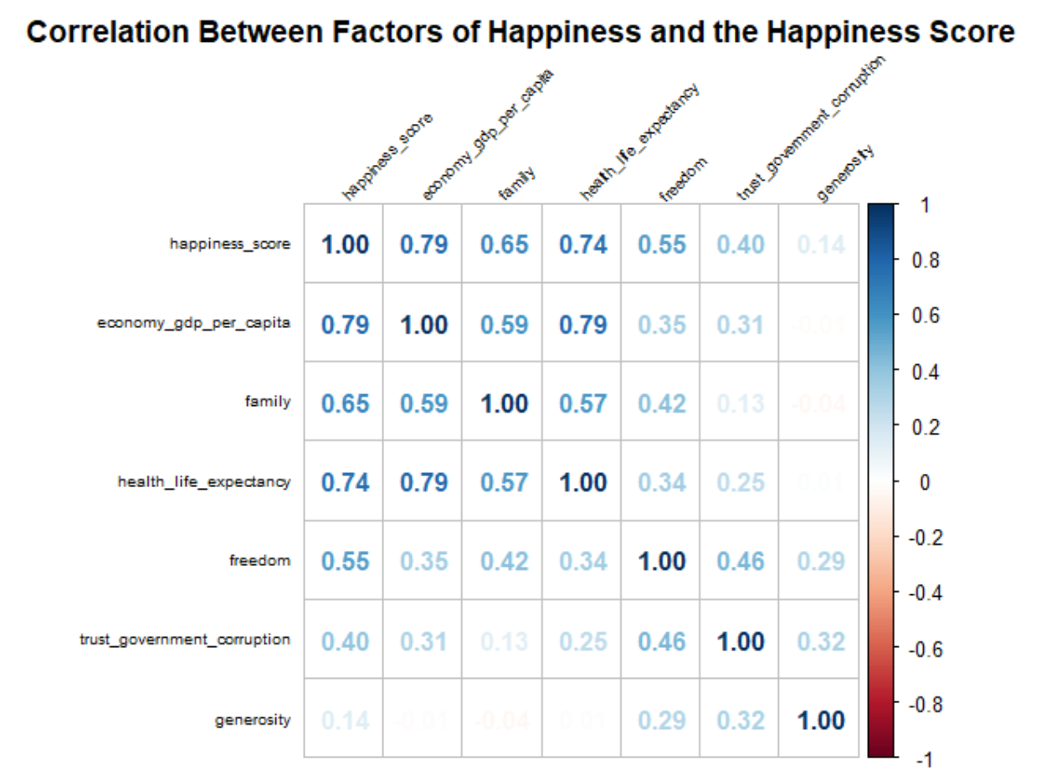
Visualization of Correlation Plot [2/2]

Slide 14
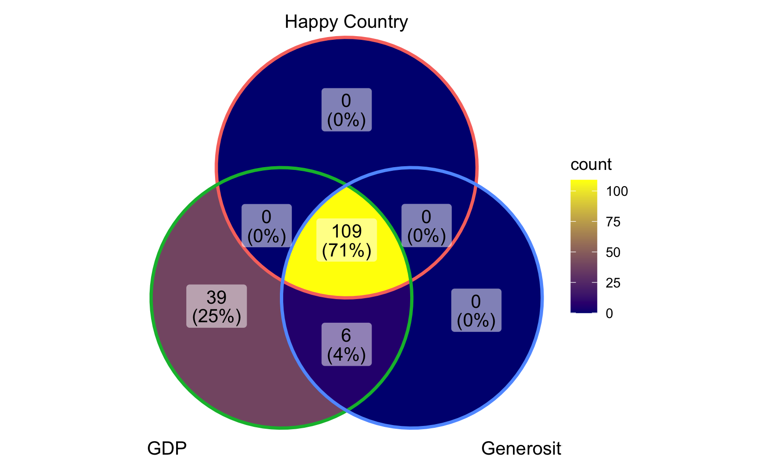
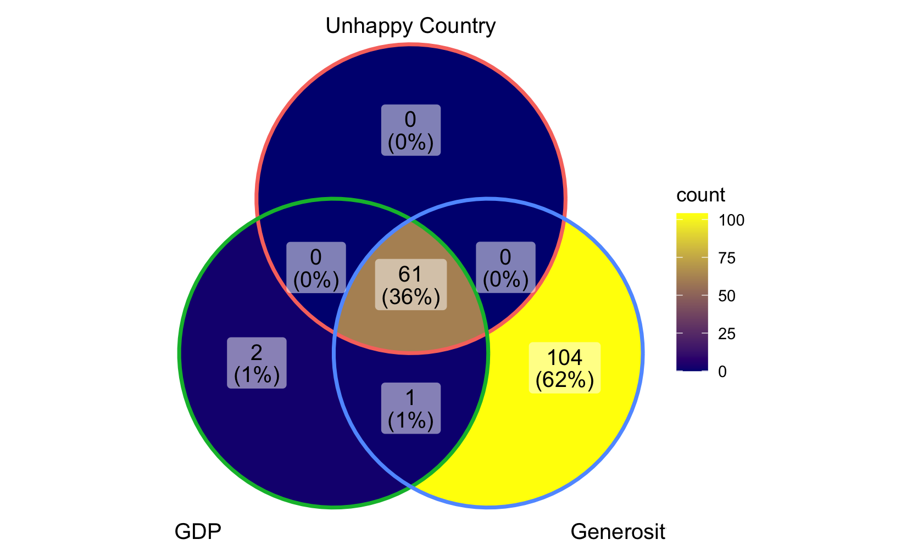
Venn Diagram
Relationships between Happiness Score, GDP and Generosity Score
What’s the relationship?

Slide 15
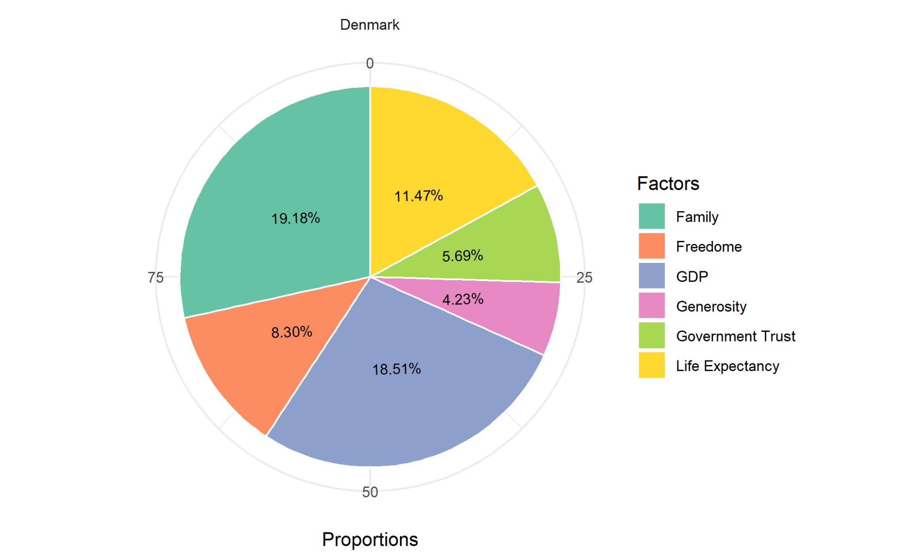
Pie Charts
Top Five Happiest Countries and Each Factor’s Contribution Percentage

Slide 16
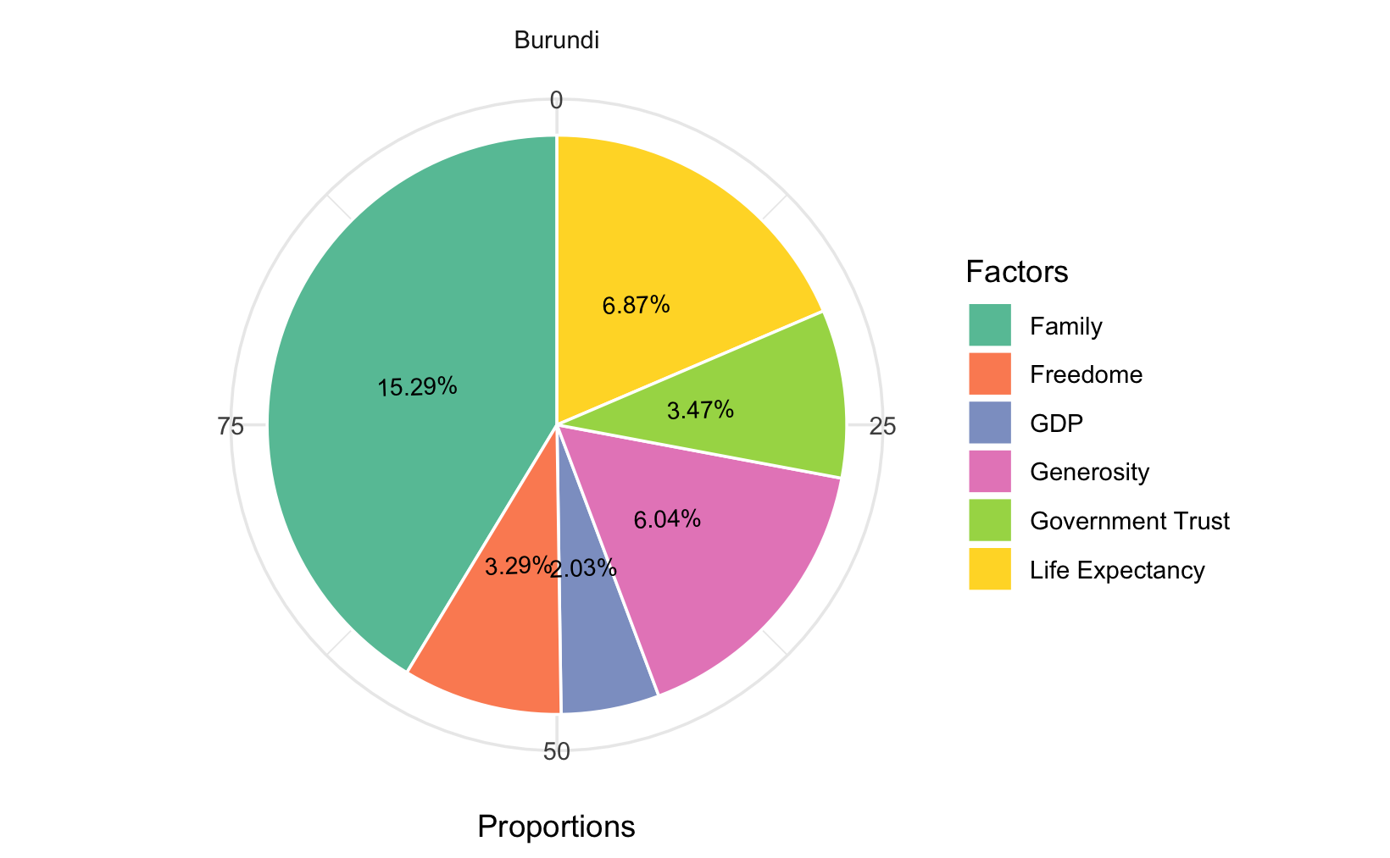
Pie Charts
Five Most Unhappy Countries and Each Factor’s Contribution Percentage

Slide 17
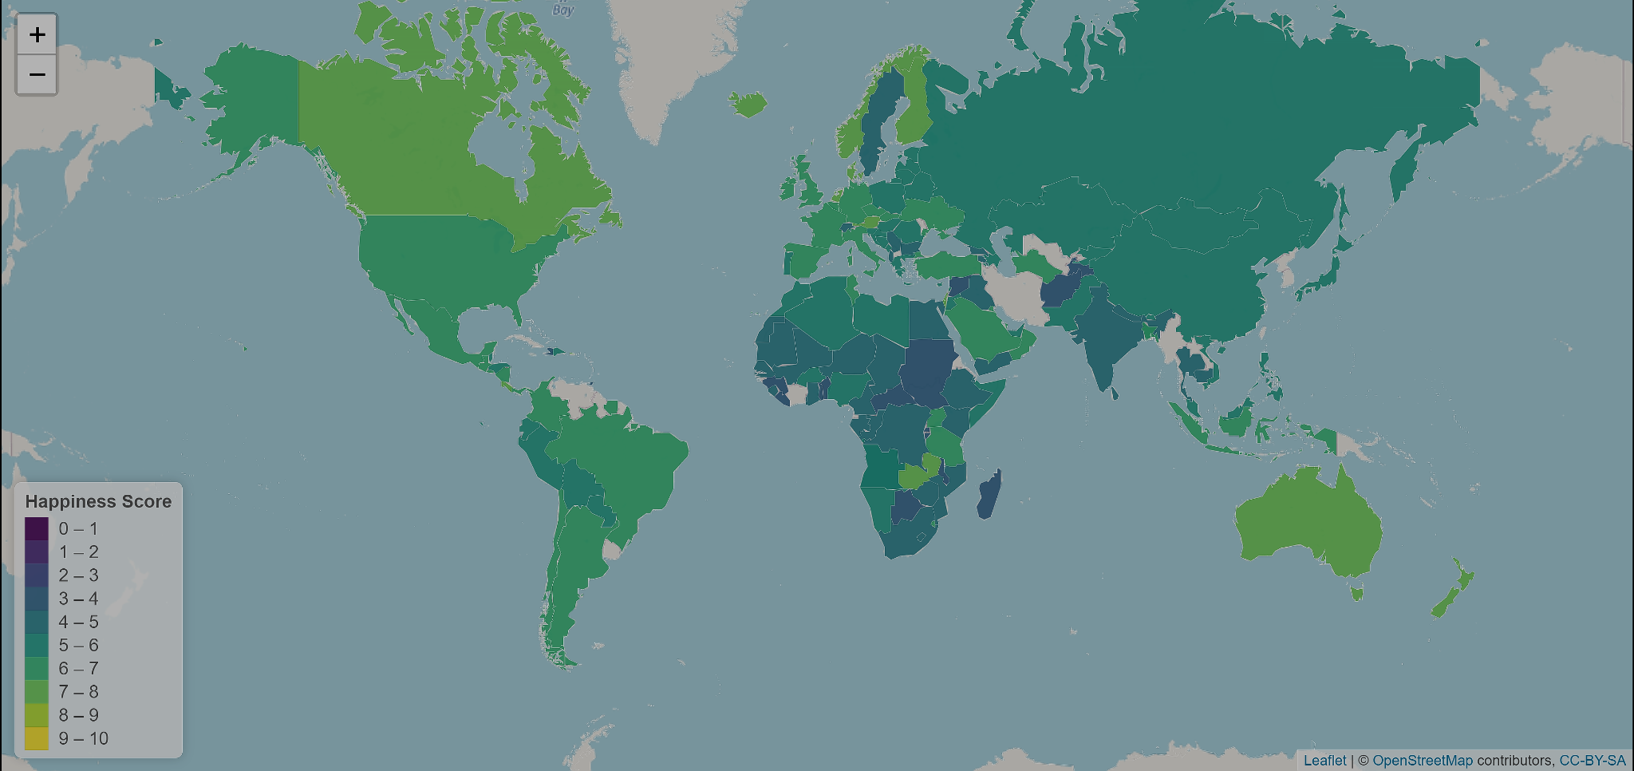
Interactive Map
Gradient Color Map of Average Global Happiness Score

Slide 18
Shiny
happiness factors change 2015-2019
Happiness factors & happiness score relationship change 2015-2019
Let’s see how the app runs!

Slide 19
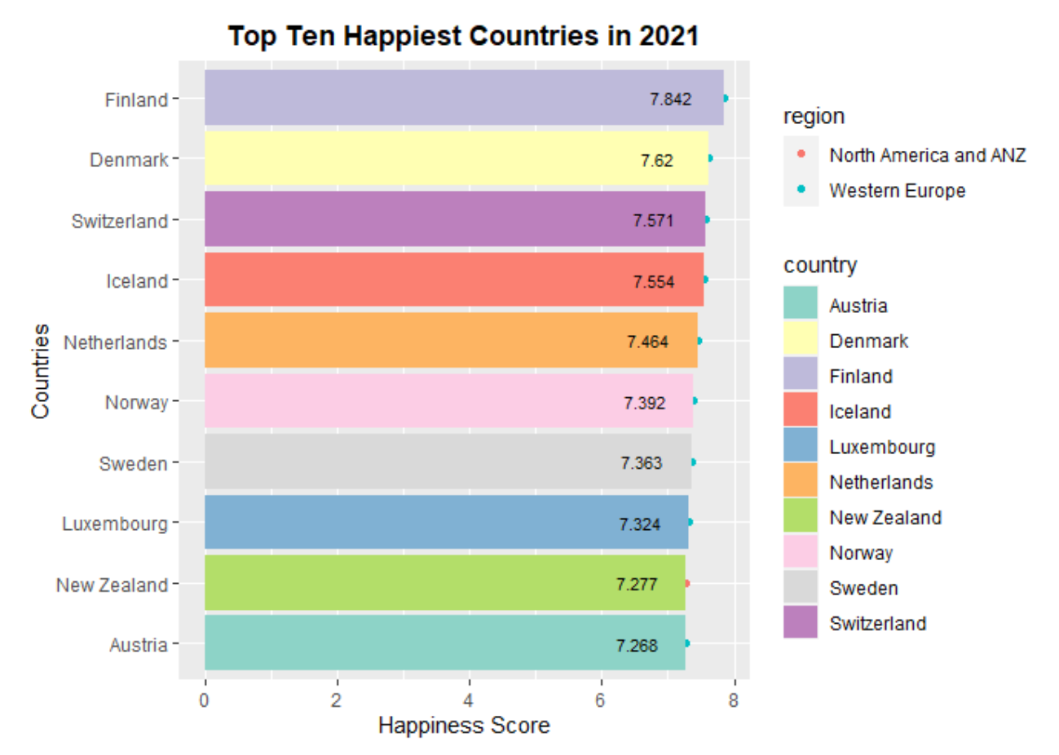
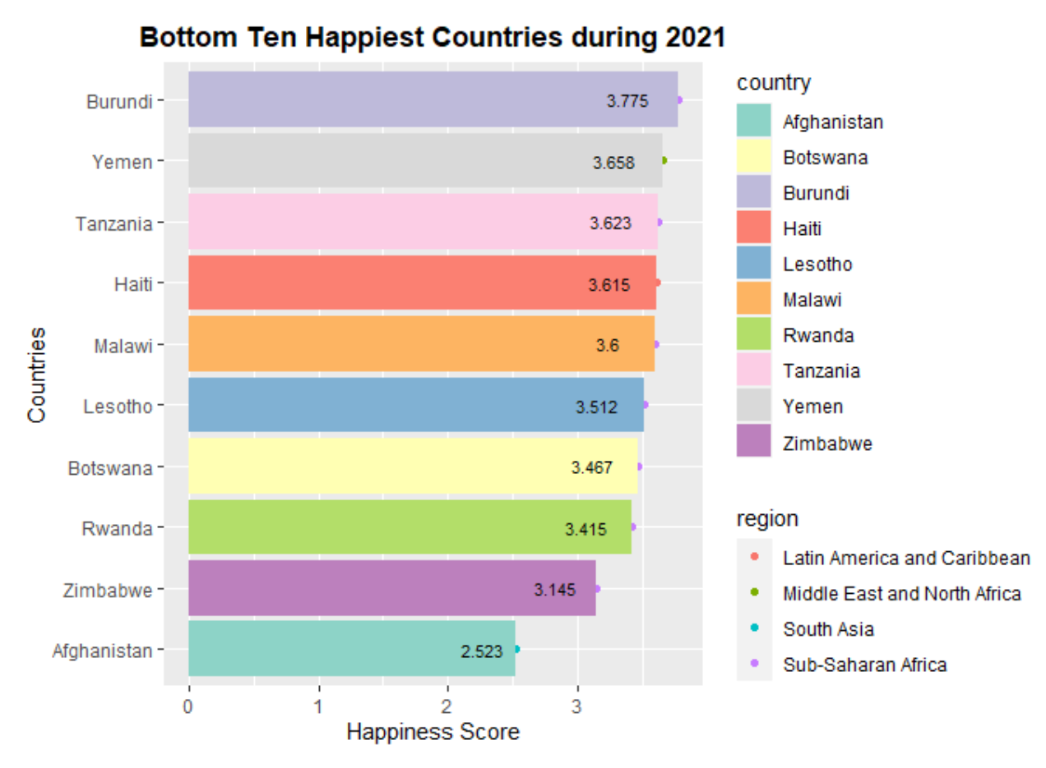
Exploring 2021 Happiness Report (if time allows)
Finland “Happiest”– “More focused on cooperation than competition, low crime, good education, better sense of equality”
Afghanistan “Saddest”– “Low life-expectancy, low GDP, mismanagement of government– **Taliban took over Afghanistan after data was collected, President fled country

Slide 20
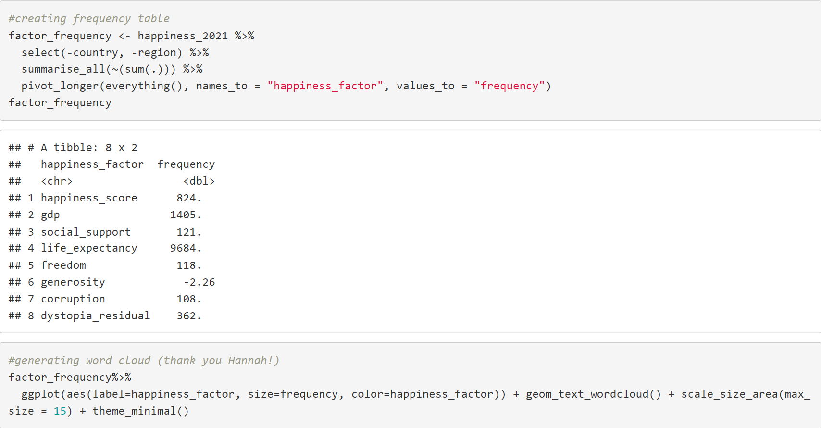
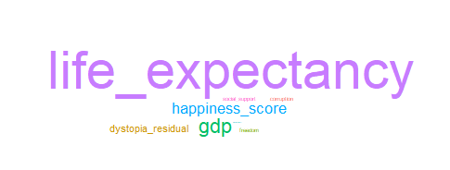
Viewing Frequency of Happiness Factors in 2021
– Using a Word Cloud –
Note: Dystopia Residual refers to a country’s difference from “a hypothetical country that has values equal to the world’s lowest national averages for each of the six factors.”

Slide 21
04
Conclusion

Slide 22
Challenges and Successes
-Reflection
Shuyi
Carmina
Yutong

Slide 23
Credits
*Larion, A., Misra, K. and Bozsolik, T. World Happiness Report 2019. *
https://www.kaggle.com/unsdsn/world-happiness/version/2
Honorable Mentions:
Professor Joel Ledford
TA- Hannah Houts

Slide 24


